Slide 1
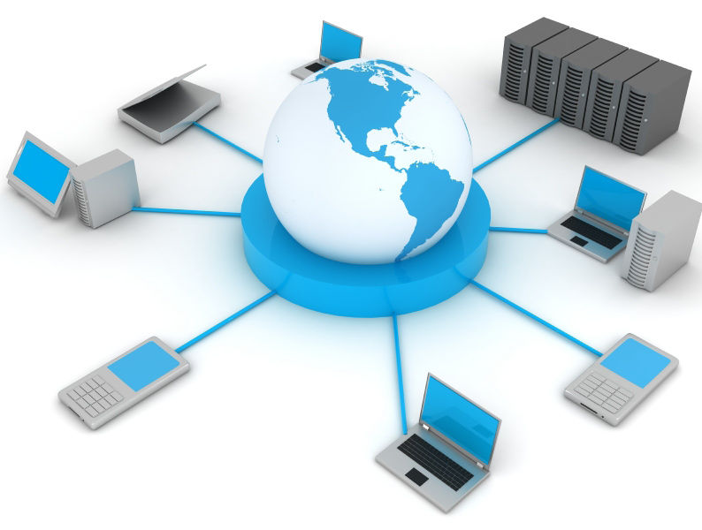
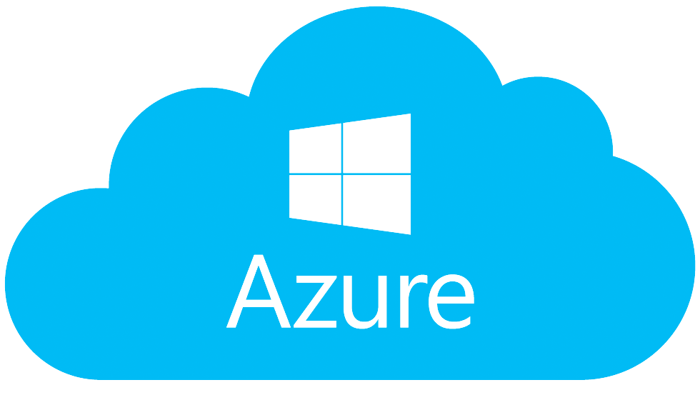
Azure, Deployment and DevOps
Docker, Azure, Application Insights, DevOps
SoftUni Team
Technical Trainers
Software University
https://softuni.bg

Slide 2
Table of Contents
Docker
Microsoft Azure
Azure Portal
Azure App Service
Application Insights
Azure DevOps
Azure Boards
Azure Repos
Azure Pipelines
Azure Test Plans
Azure Artifacts

Slide 3
Have a Question?
sli.do #csharp-web

Slide 4
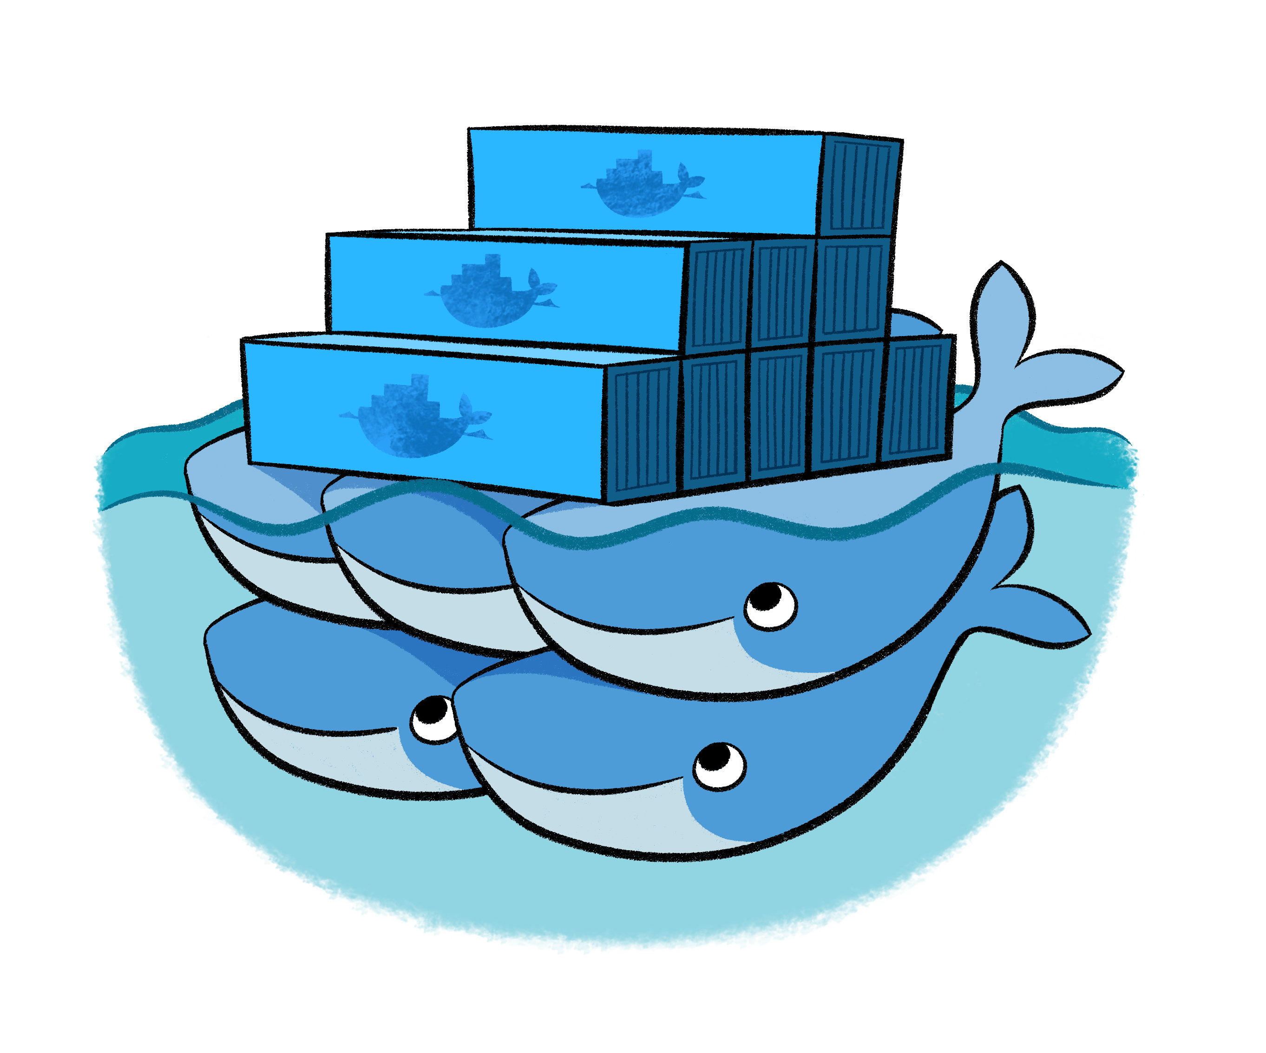
Docker

Slide 5
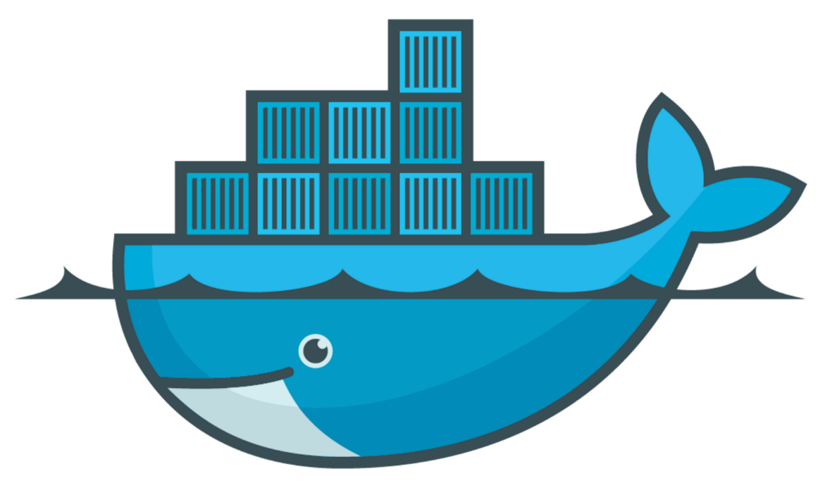
Docker (1)
Docker is a software that performs operating-system-level virtualization
The process is also known as "containerization"
Docker runs software packages called "containers"
Containers are isolated from each other
Each bundles its own application, tools, libraries, configuration files etc.
They can communicate with each other through well-defined channels
All containers are run by a single Operating System
This makes them significantly more lightweight than virtual machines
Containers are created by "images" that specify their contents

Slide 6
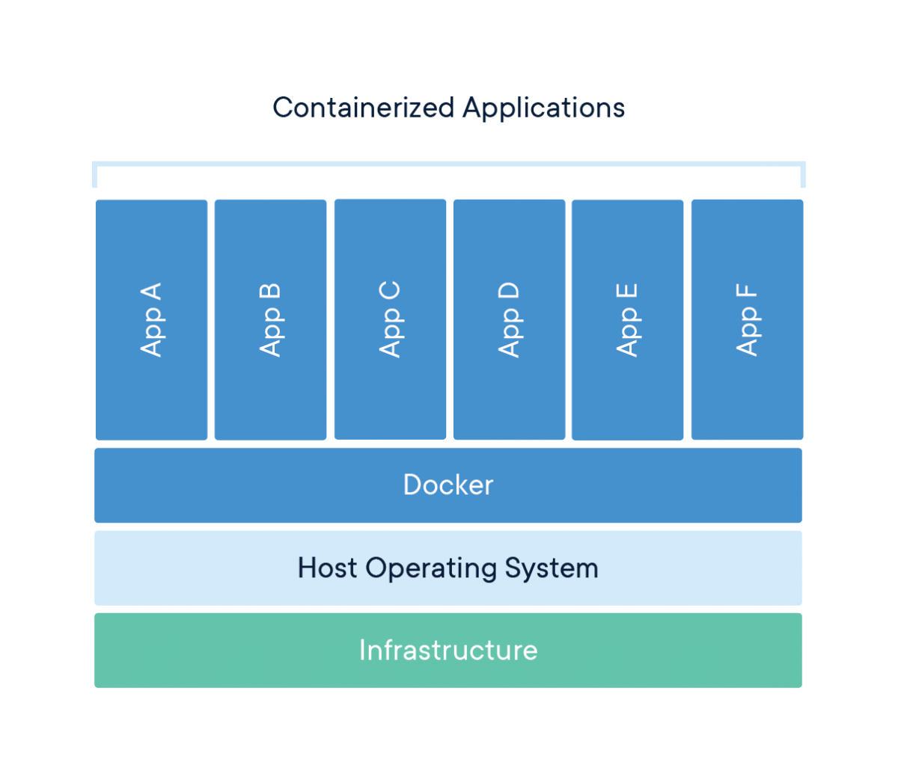
Docker (2)

Slide 7
Docker Container
Containers are standard units of software
Each packages up code and dependencies to improve the app
Images are lightweight, standalone, executable packages of software
Containers Images become containers at runtime
In Docker, they become containers when ran on Docker Engine
Always runs the same way, regardless of the Operating System
Containers that run on the Docker Engine include:
Standard Containers, Lightweight Containers, Secure Containers

Slide 8
Microsoft Azure

Slide 9

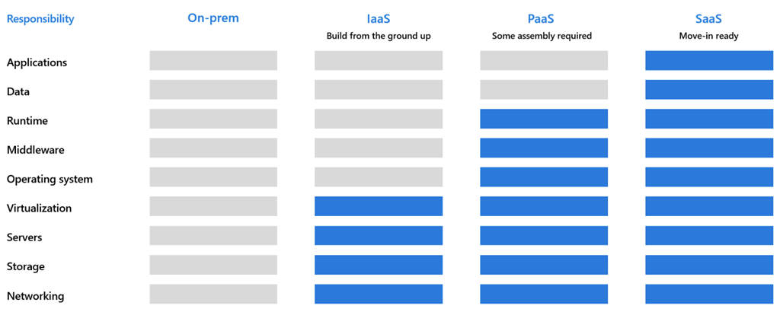
Microsoft Azure (1)
Microsoft Azure is a cloud-computing service
Designed for building, testing, deploying and managing apps
Applications and services are managed through a global network
Microsoft Azure provides and supports
On-premise
Infrastructure-as-a-Service (IaaS)
Platform-as-a-Service (PaaS)
Software-as-a-Service (SaaS)
Many different languages, tools and frameworks

Slide 10
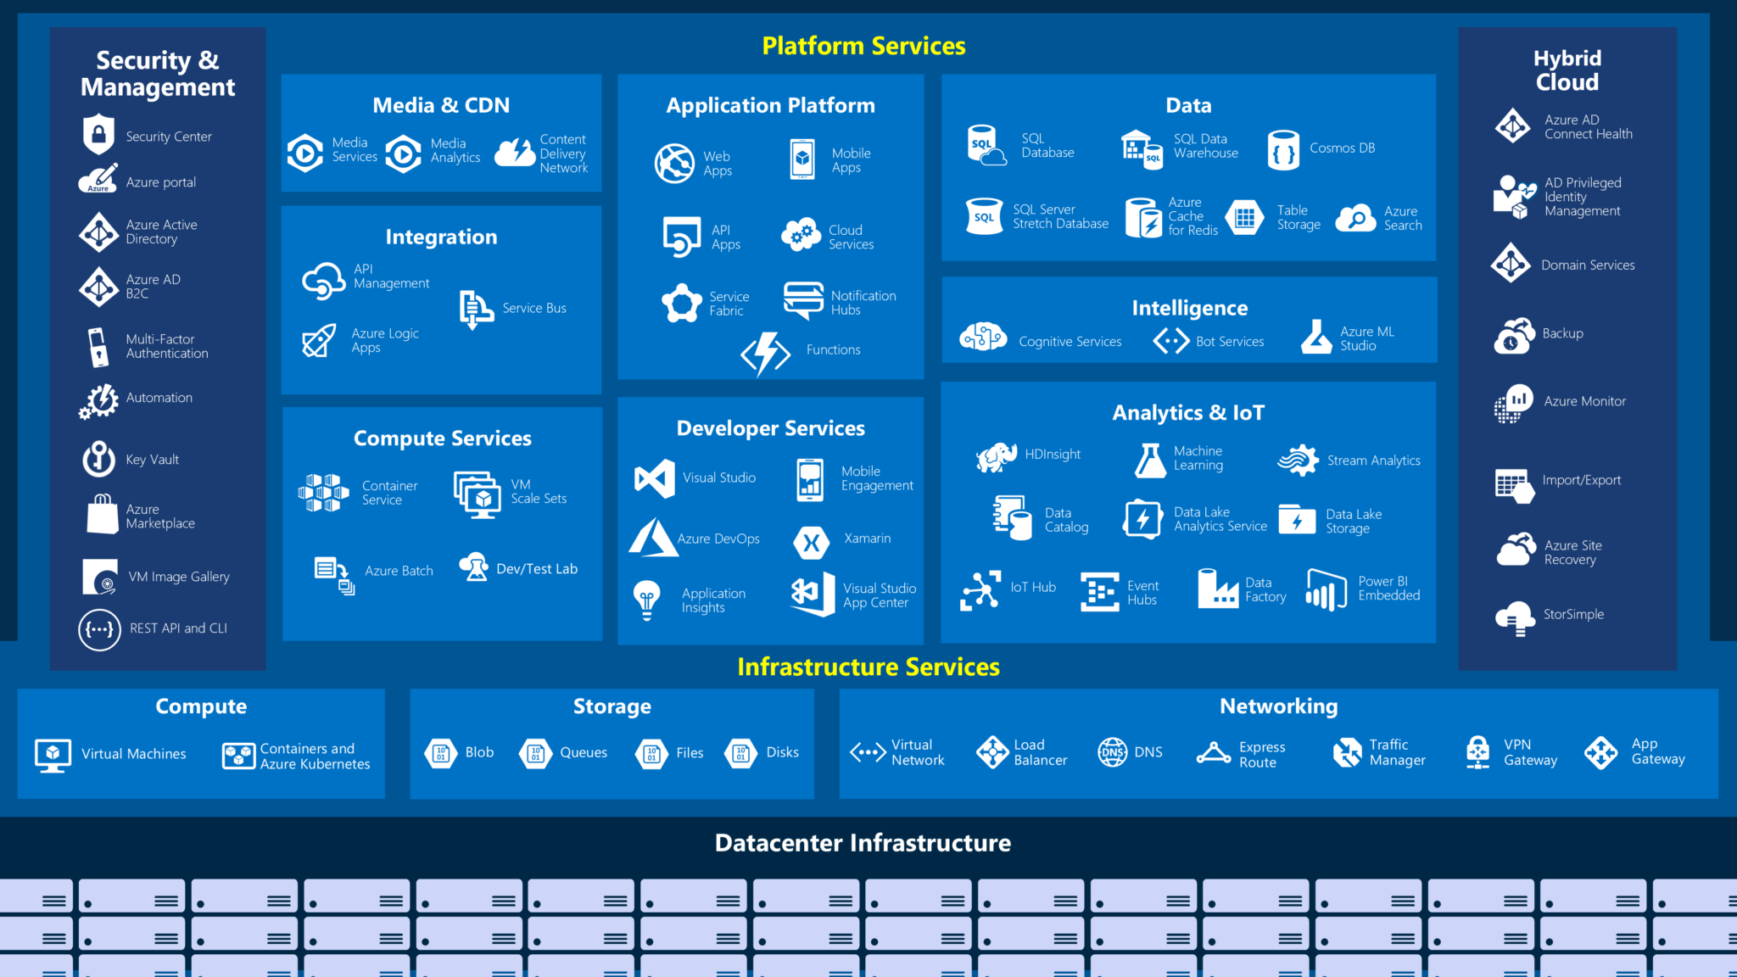
Microsoft Azure (2)
Some of the most important Microsoft Azure Services include:
Application Services
Storage Services
Data Management
Data and Analytics
Networking/Security
ML and AI
Developer
Azure App Service
Application Insights
Azure DevOps

Slide 11
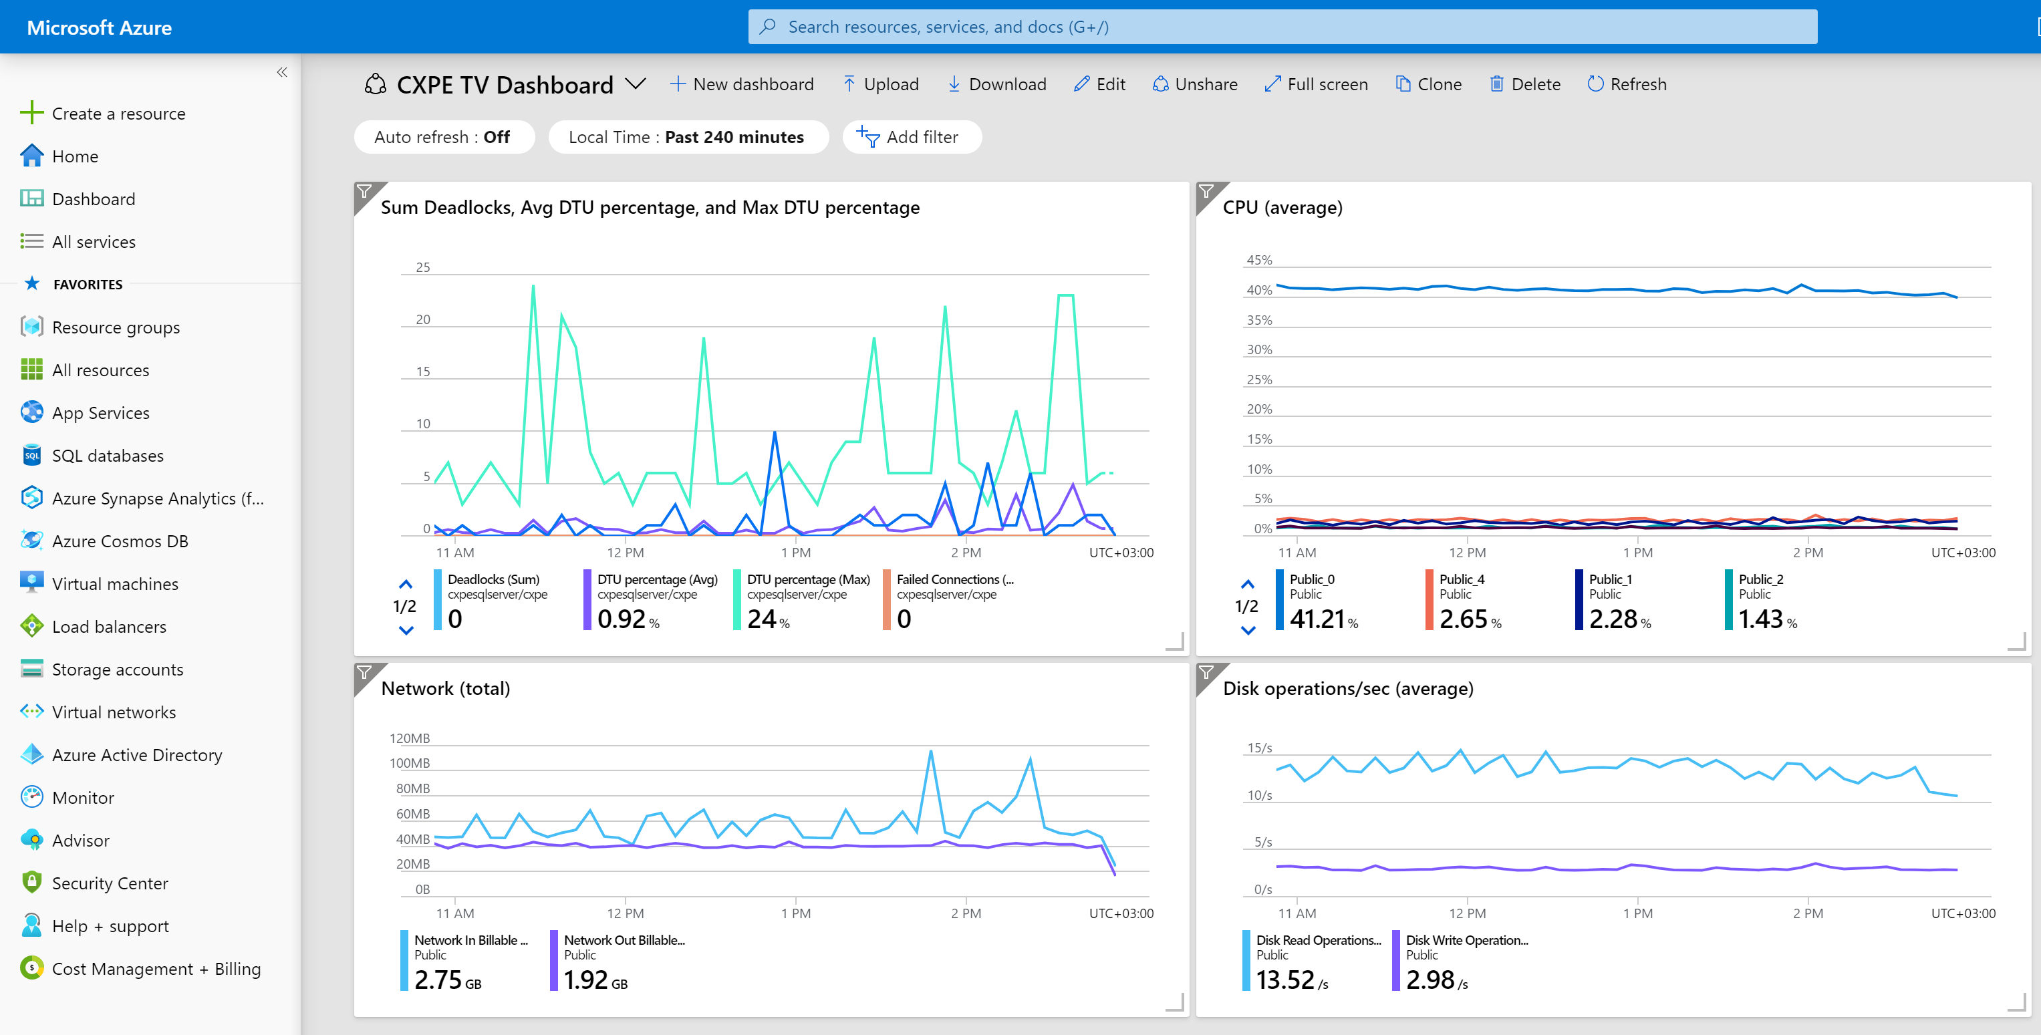
Azure Portal
11

Slide 12

Azure App Service
Create Powerful Cloud Apps

Slide 13
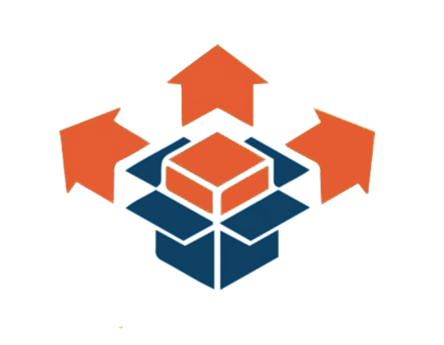

Deployment
Deployment includes all the activities, making a system available for use
Naturally, it is to be referred to as a general process
Most systems have little to nothing in common In terms of business logic
Therefore, every system has its own precise processes and procedures
Deployment activities include:
Configuration, Testing
Installation & Activation
Deactivation & Uninstallation
Release, Deploy, Update, Version Tracking, Adaptation etc...

Slide 14

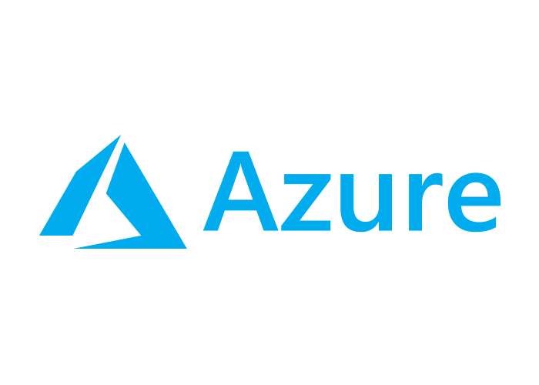
Azure App Service
Azure App Service is a platform for build / host web apps
The applications can be on a technology of any choice
Infrastructure management is non-mandatory
Offers Auto-Scaling, High Availability
Supports both Windows & Linux
Azure App Service offers automated deployment
Deployment can be done from different platforms
GitHub, Azure DevOps, or any Git repo

Slide 15
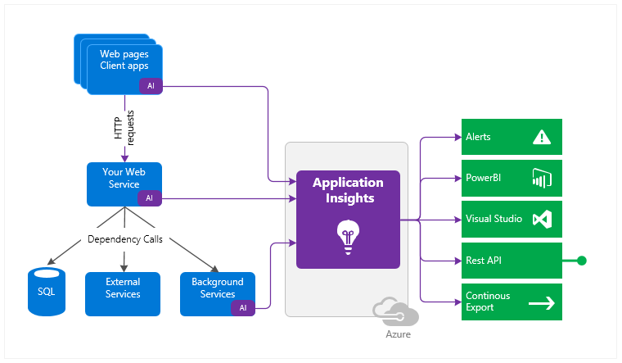
Application Insights

Slide 16

Application Insights
Application Insights is an extensible APM service for web developers
Application Performance Management
Used to monitor live web applications
Automatically detects performance anomalies
Application Insights includes
Powerful analytics tools for diagnostics
Analytics over client usage on the app
Designed to help with improvement of performance and usability

Slide 17

Application Insights
Application Insights Installation is quite simple
You install a small instrumentation package in your app
You setup an Application Insights resource in the Azure portal
The instrumentation monitors your app and sends telemetry data
Data is sent directly to the Azure portal
The application can run anywhere
It doesn't have to be hosted on Azure
Aside from the web services, you can instrument other components

Slide 18
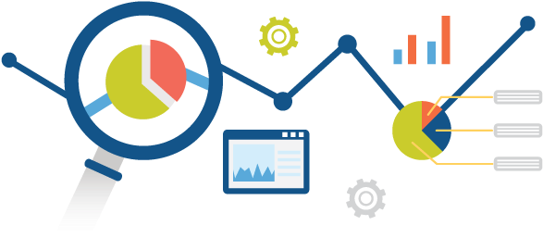
Application Insights
Application Insights monitors several essential things
Request rates, Response times, Failure rates
Dependency rates, Exceptions, AJAX calls
Page views and load performance
User and session counts, Performance counters
Host diagnostics, Diagnostic trace logs
Custom events and metrics

Slide 19
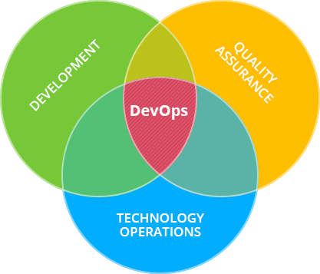
Azure DevOps

Slide 20
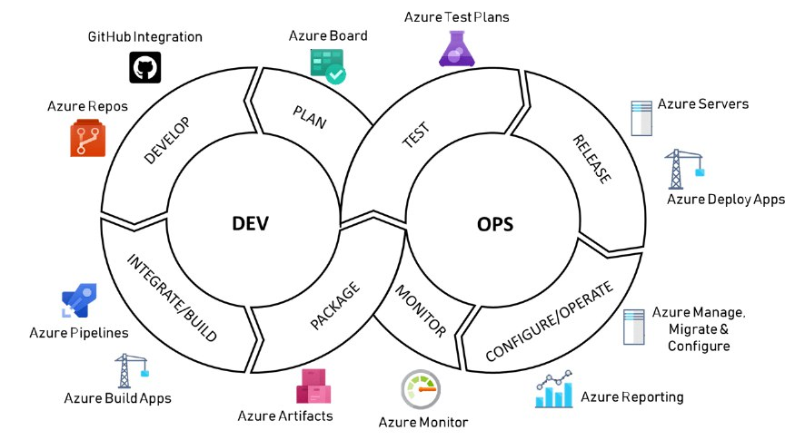
Azure DevOps
DevOps
Software Development (Dev)
Technology Operations (Ops)
DevOps aims to optimize the systems development lifecycle
Unifies processes such as code, build, test, deliver, monitor etc.
DevOps Engineers are treated as the "Special Forces" of a company
Basically, If you are a DevOps Engineer, you do all the stuff...

Slide 21






Azure DevOps
Azure DevOps is a set of tools and services for DevOps
Azure Boards
Azure Pipelines
Azure Repos
Azure Test Plans
Azure Artifacts
Extensions Marketplace
A catalog of Azure DevOps extensions

Slide 22
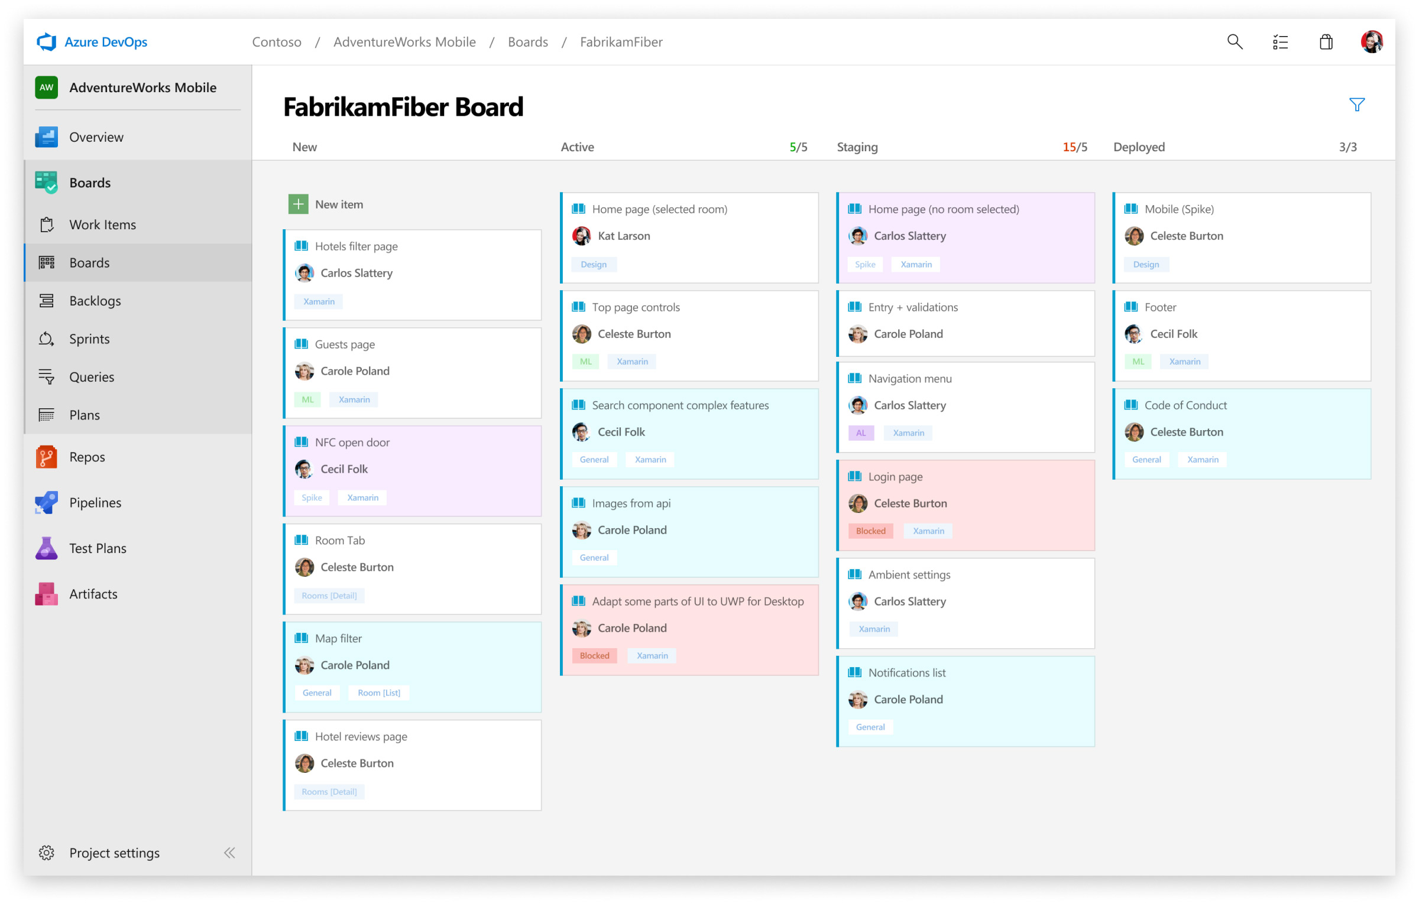
Azure Boards
Plan, Track, and Discuss Work Across Teams

Slide 23


Azure Boards
Azure Boards is a set of tools for Agile Development
Kanban Boards, backlogs, team dashboards, custom reporting
Drag-and-Drop sprint planning, Flexible work item tracking
Azure Boards is extremely convenient and widely used
Customizable dashboards, workflows, boards...
Scrum ready, Built for insights
Absolutely free for Open-source projects and small teams

Slide 24
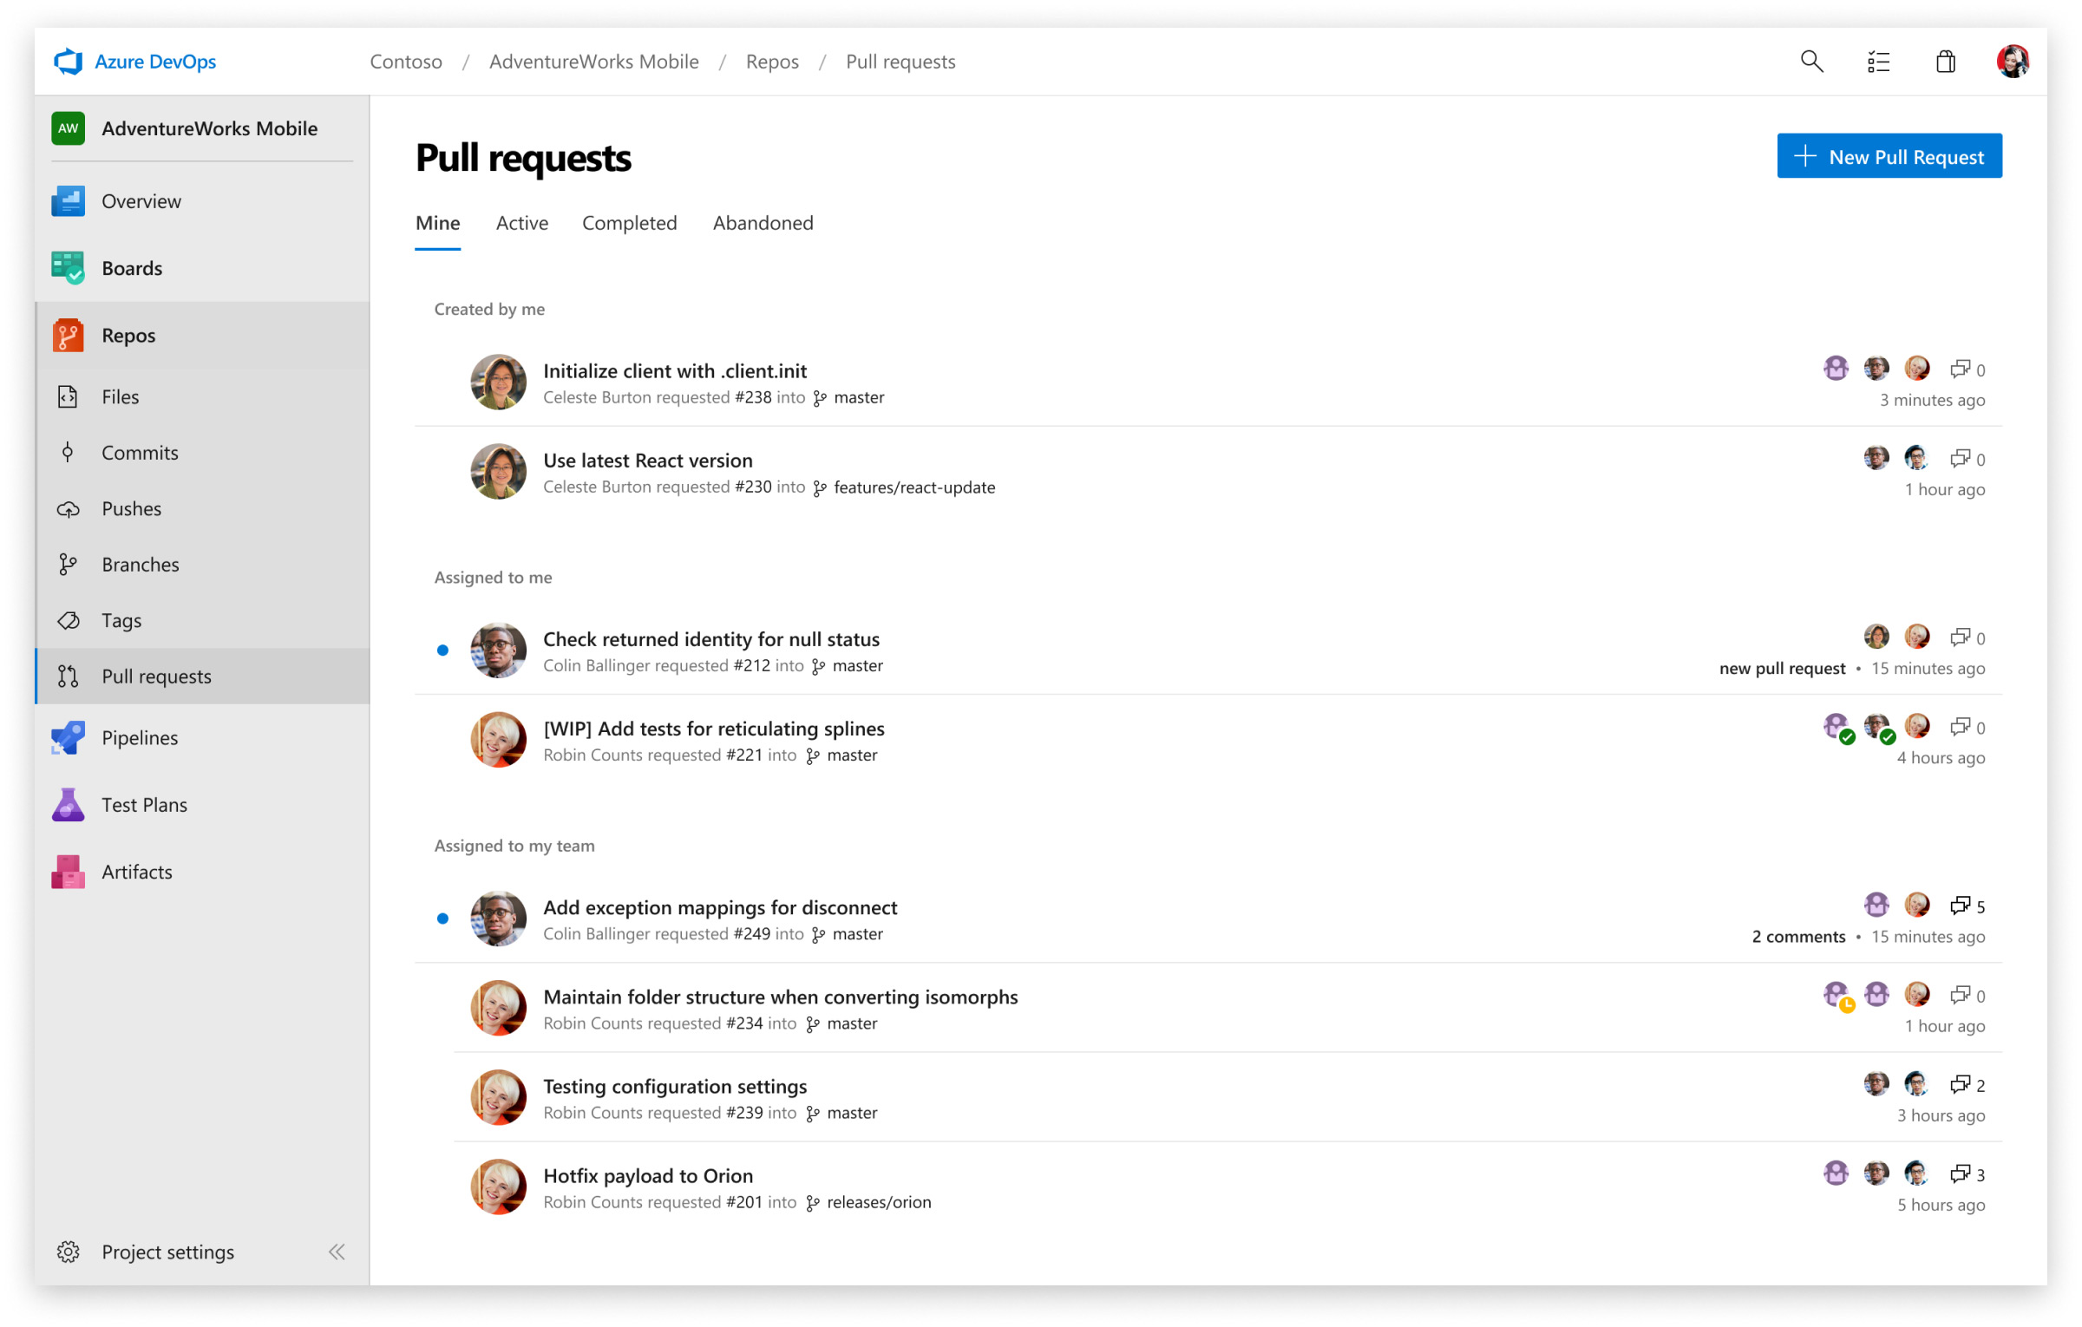
Azure Repos
Unlimited, Cloud-hosted Private Git Repos

Slide 25


Azure Repos
Azure Repos – free private Git repositories, pull requests etc
Unlimited private Git repositories hosting and support
Designed for TFVC
Azure Repos provides
Support for any Git client, Automation with built-in CI / CD
Web hooks & API integration, Branching policies
Semantic code search, code reviews, threaded discussions
Absolutely free for open source projects and small teams

Slide 26
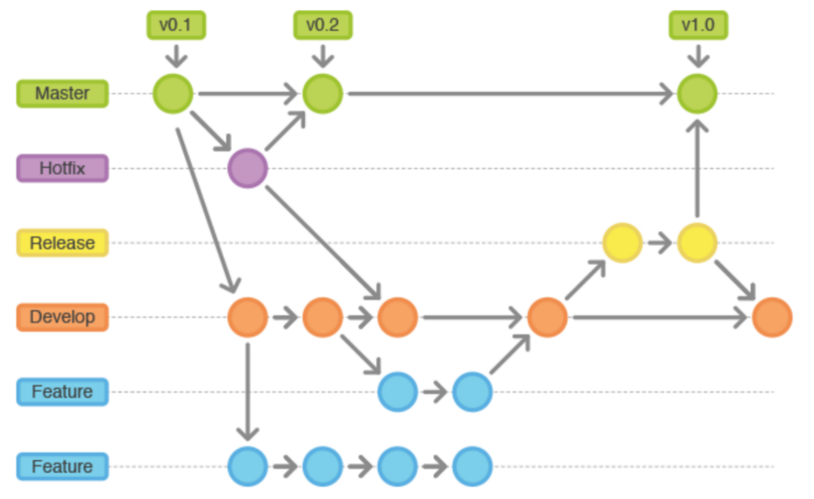
Gitflow Workflow
Defines a strict git branching model designed around the project release. All work is done in the dev branch.
The master branch is the production-ready version
The dev branch is where all feature branches are merged after pull requests
Once it's time for a release, a release branch should be created from the dev branch

Slide 27
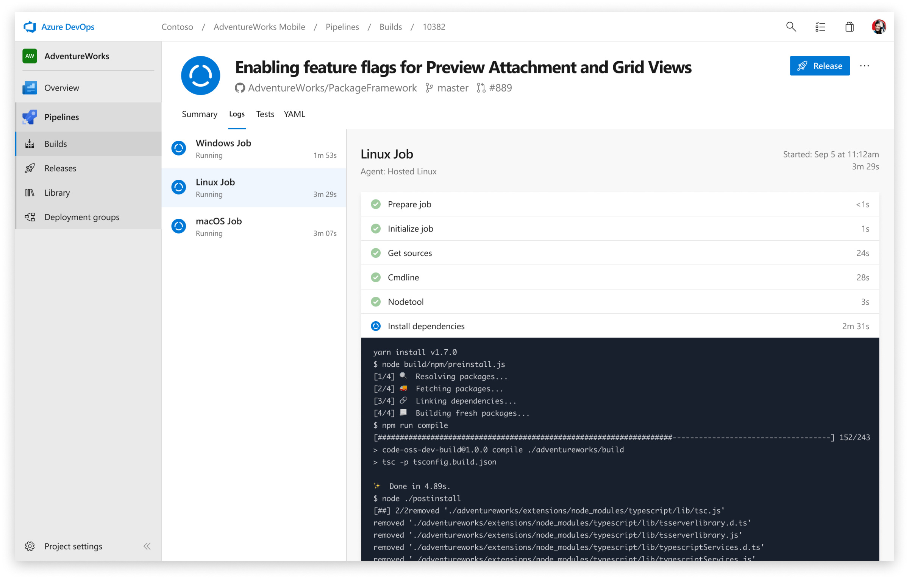
Azure Pipelines
Continuously Build, Test, and Deploy

Slide 28

Azure Pipelines
Azure Pipelines is a set of tools for building, testing & deployment
Cloud-hosted pipelines for Linux, macOS and Windows
Unlimited time + 10 free parallel jobs for Open Source projects
Azure Pipelines automates build and deployment processes
Optimizing your time with the "nuts & bolts"
Any language, any platform. Deploy to any cloud
Containers & Kubernetes. Best-in-class for Open Source
Extensible. Advanced Workflows and Features

Slide 29
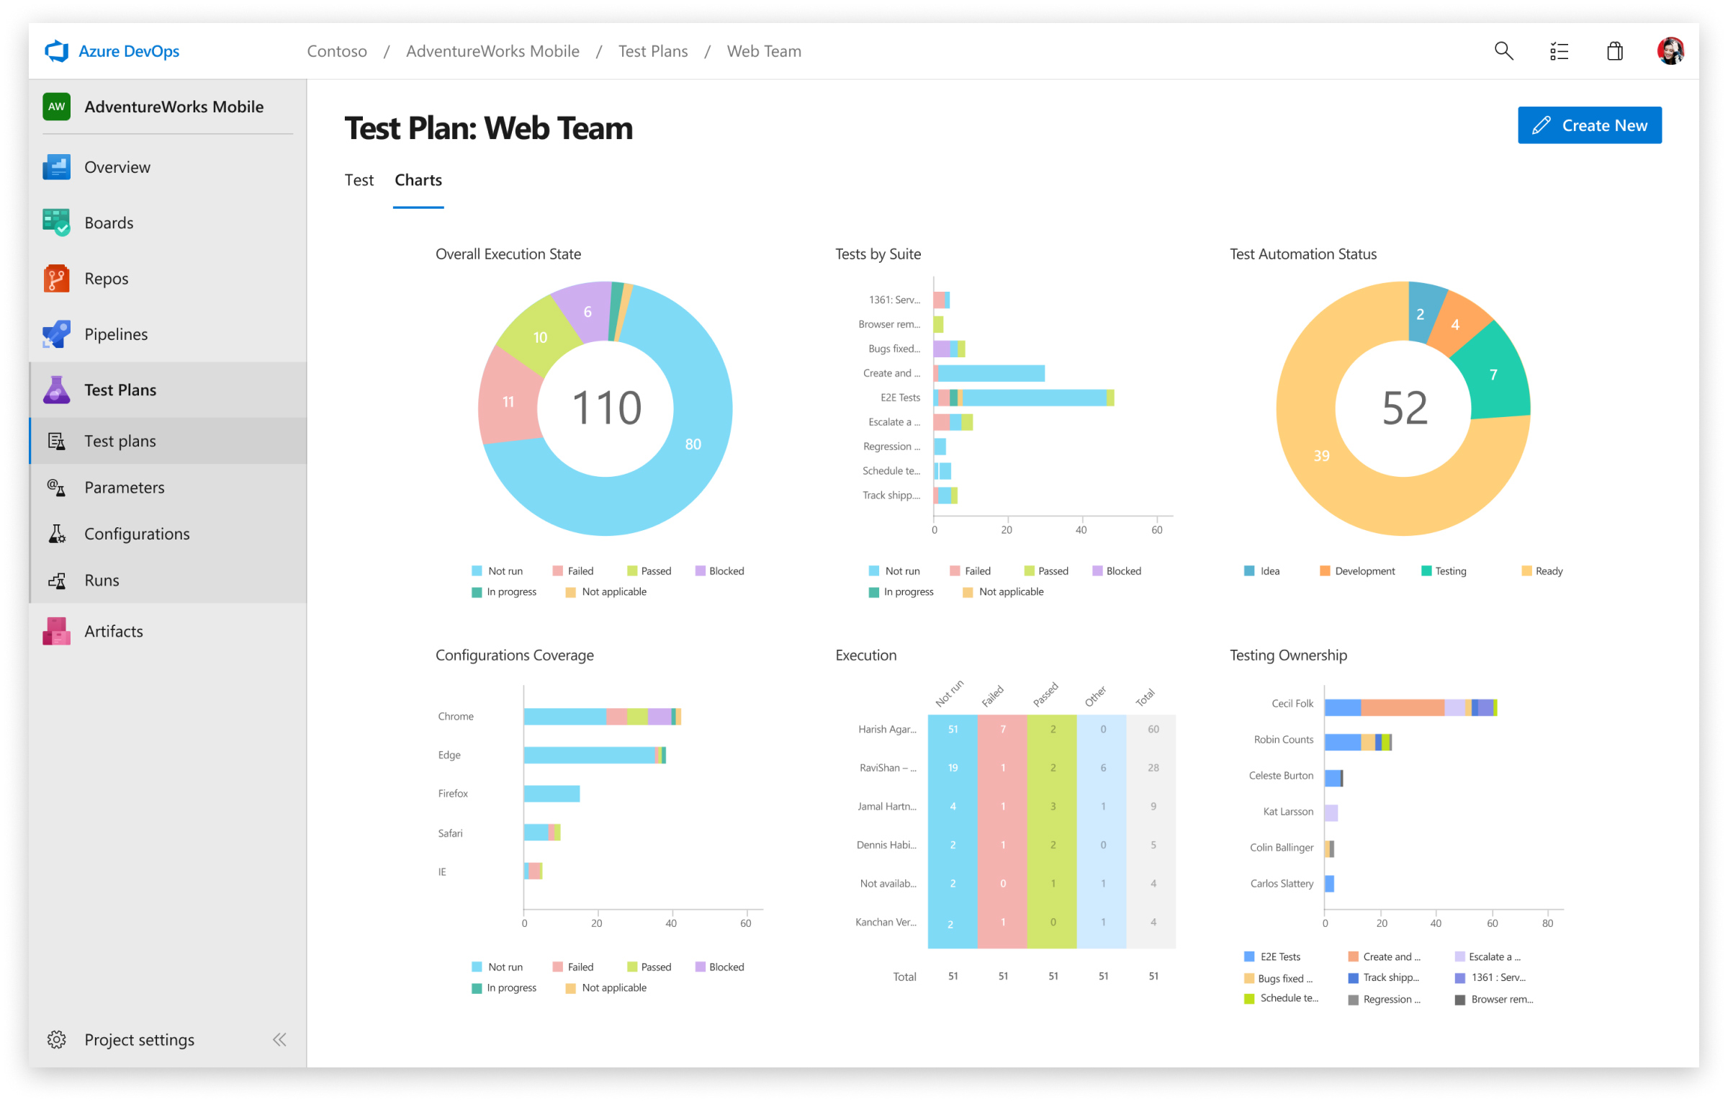
Azure Test Plans
Test and Ship With a Testing Toolkit

Slide 30
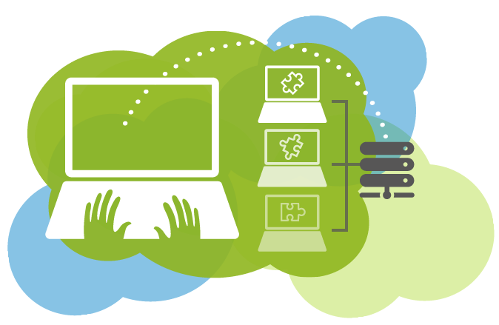
Azure Test Plans
Azure Test Plans – planned and exploratory testing solution
A toolkit for manual and exploratory testing
If you aim for Automation of CI / CD workflow – Azure Pipelines
Azure Test Plans provides many convenient features
Capturing rich data, End-to-End traceability
Testing across web and desktop
Planned manual testing
Exploratory testing

Slide 31
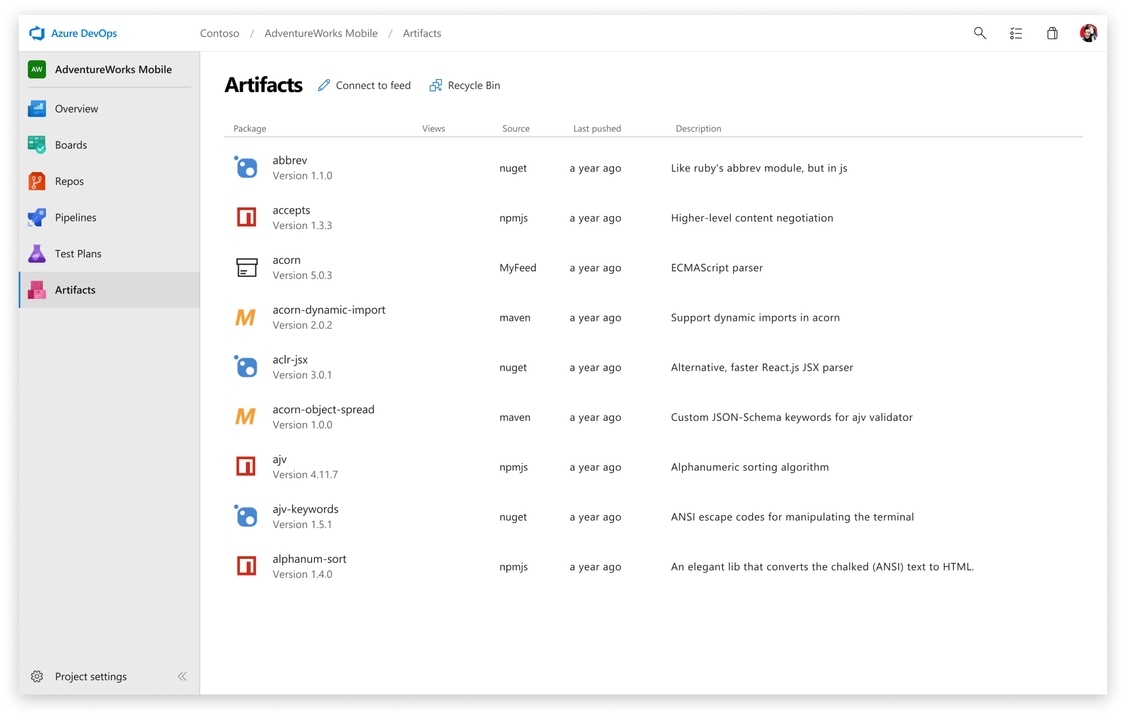
Azure Artifacts
Create, Host, and Share Packages with Your Team

Slide 32
Azure Artifacts
Azure Artifacts is a package management tool
Create and share packages from Maven, npm, NuGet etc
Provides fully integrated package management for CI / CD
Azure Artifacts includes many features, such as:
Sharing code efficiently, Adding packages to any pipeline
Managing all package types, Protecting packages
Simplifying complex build jobs, Organizing artifacts
Integrating package handling to CI / CD Pipelines

Slide 33
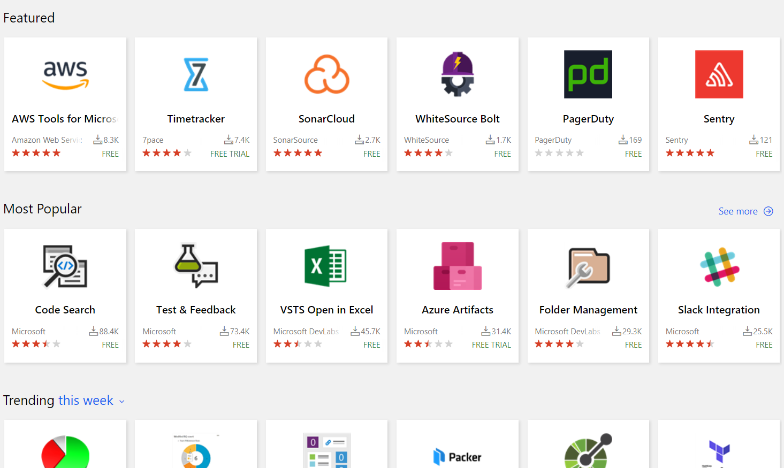
Extensions Marketplace
Extensions for Azure DevOps

Slide 34
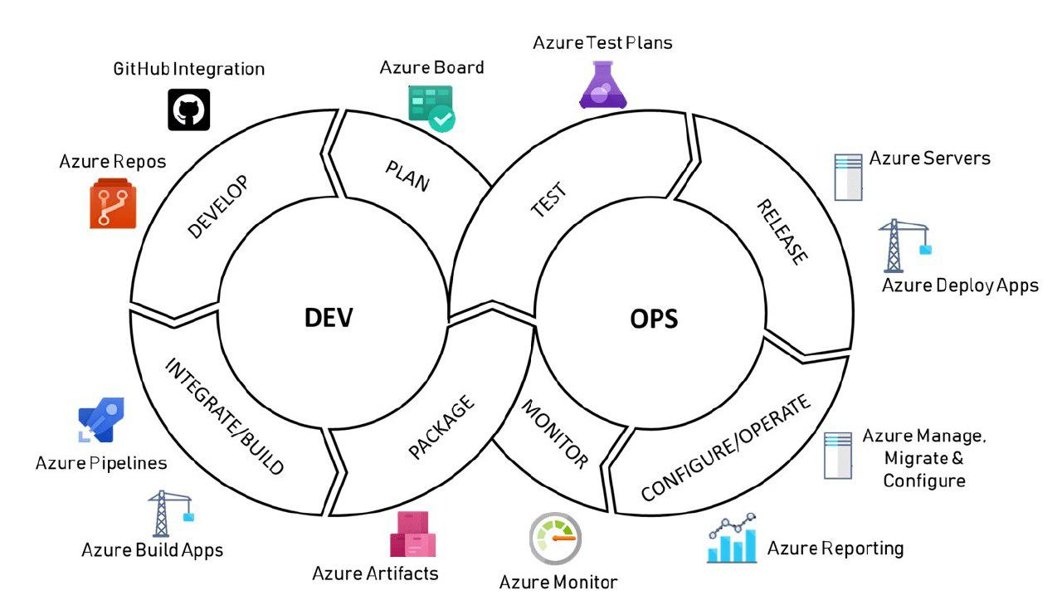

Slide 35

Summary
Docker
Microsoft Azure
Azure Portal
Azure App Service
Application Insights
Azure DevOps
Azure Boards
Azure Repos
Azure Pipelines
Azure Test Plans
Azure Artifacts
…
…
…

Slide 36
Questions?
Notes:
36

Slide 37
Trainings @ Software University (SoftUni)
Software University – High-Quality Education, Profession and Job for Software Developers
softuni.bg, softuni.org
Software University Foundation
softuni.foundation
Software University @ Facebook
facebook.com/SoftwareUniversity
Software University Forums
forum.softuni.bg
Notes:
37

Slide 38

License
This course (slides, examples, demos, exercises, homework, documents, videos and other assets) is copyrighted content
Unauthorized copy, reproduction or use is illegal
© SoftUni – https://softuni.org
© Software University – https://softuni.bg
Notes:
38

